Slide 1
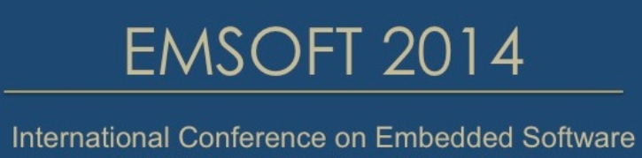
Building High-Performance Smartphones
via Non-Volatile Memory: The Swap Approach
Kan Zhong, Tianzheng Wang, Xiao Zhu, Linbo Long, Duo Liu,
Weichen Liu, Zili Shao, Edwin H.-M. Sha

Slide 2
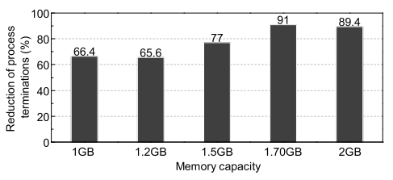
Motivation
In smartphone, process killed when memory is under pressure.
Because swapping to flash is hard to avoid sacrificing performance.
However, swapping is an important technique to extend main memory.
Build the swap area with NVM to allow high performance without sacrificing user experience.

Slide 3
Background
Byte-Addressable NVM
Pros: low power consumption, high density and byte-addressability
Cons: access latency, limited write endurance
→ wear leveling, caching schemes
Why NVM?
→ can be built as DIMMs
→ near DRAM performance
→ better endurance than flash

Slide 4
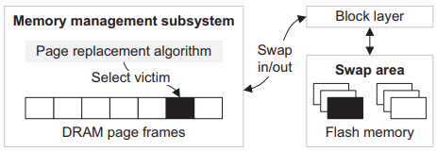
Background
Swapping
An effective way to extend memory by borrowing space from I/O devices
(e.g., flash and disks) in modern operating systems.
Swapping occurs to satisfy memory allocation requests under memory pressure.
Traditional flash-based swap

Slide 5
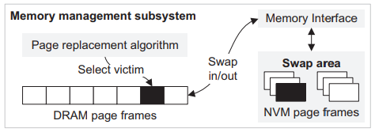
NVM-Based Swapping
Attach NVM directly to the memory bus
Eliminating I/O and the whole storage stack overheads.
Besides DRAM, NVM area shares the same physical address space with DRAM.
OS knows which address space range belongs to DRAM and NVM upon start.
The OS can manage NVM via page table.
NVM-based swap
Two additional optimizations
Copy-on-Write Swap-In (COWS)
Heap-Wear

Slide 6
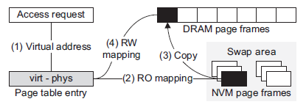
NVM-Based Swapping
Copy-on-Write Swap-In (COWS)
Avoiding unnecessary memory copy operation (Read)
→ better performace
Swapping occurs to satisfy memory allocation requests under memory pressure.
Copy-on-write swap-in (COWS)

Slide 7
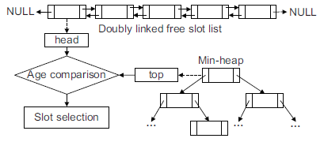
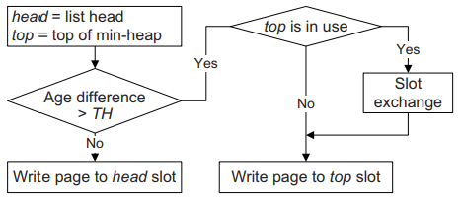
NVM-Based Swapping
Heap-Wear
Avoiding fast worn-out of certain NVMs.
→ Using linked list for free slots and min-heap sorted according to age.
Free slot list & min-heap Slot selection in Heap-Wear

Slide 8
Experimental Setup
Google Nexus 5 smartphone
Qualcomm Snapdragon 800 processor
2GB DRAM as main memory
16GB internal flash storage
Linux kernel 3.4 for Android
Swap variants
Flash-based
DRAM-based
NVM-Swap
Application
Brower, Social networking, Multimedia, Office, Gaming, Online shopping, News

Slide 9
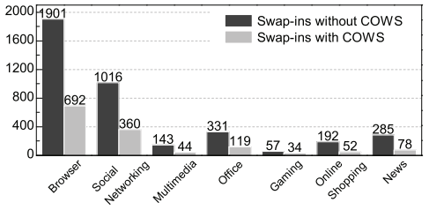
Evaluation
Number of memory copy operations.
COWS can help reduce around 40%~75% of swap-ins.
Memory copy reduction results for each application category.

Slide 10
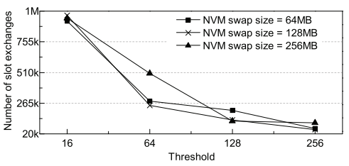
Evaluation
Wear-leveling.
With the same threshold, the NVM swap size does not affect the number of slot exchanges drastically.
Number of slot exchanges in Heap-Wear with different swap sizes and thresholds.

Slide 11
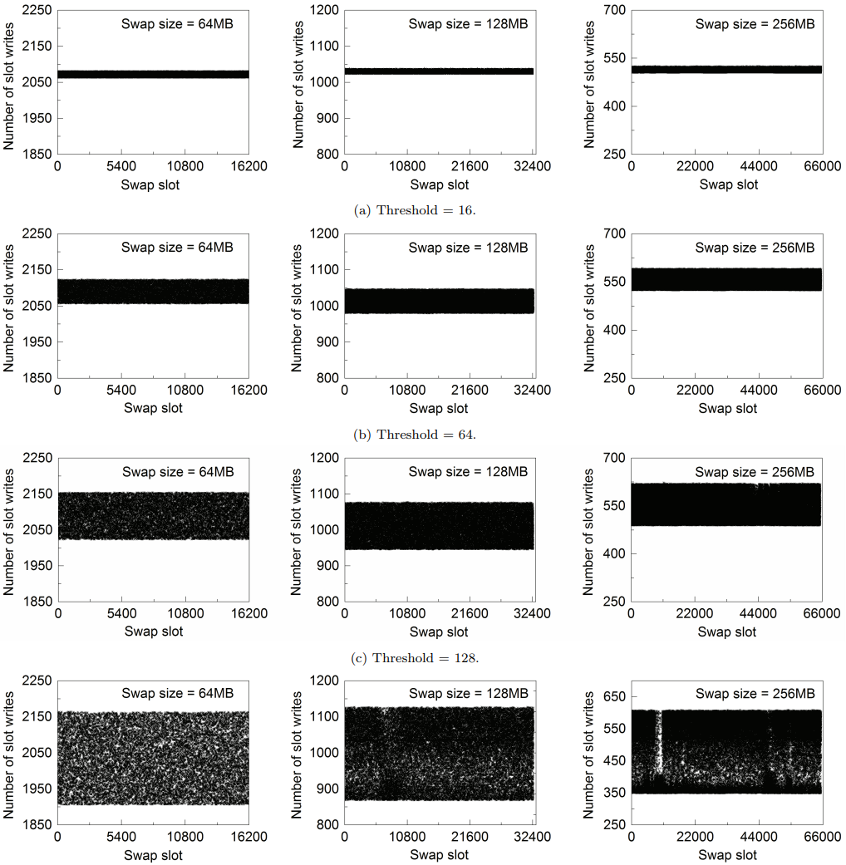
Evaluation
Wear-leveling.(Cont.)
Threshold determines the degree of
wear leveling.
→ smaller threshold distribute
writes more evenly, but require
more slot exchanges.
Write distribution of NVM-Swap with
different swap area sizes and thresholds.

Slide 12
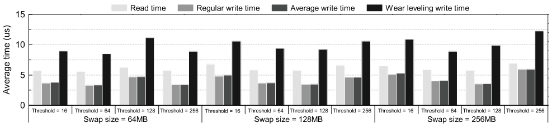
Evaluation
Wear-leveling.(Cont.)
Slot exchanges only comprise a small part of the total swap-outs.
Access delay of NVM swap area.

Slide 13
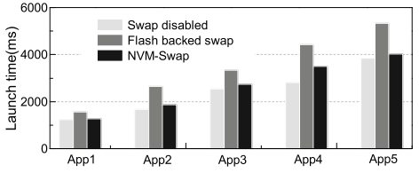
Evaluation
Application launch time
Compared to flash-based swap, NVM Swap is more than 20% faster on average.
Application launch time under different swap implementations.

Slide 14
Conclusion
Replace part of the DRAM with NVM, and use it as a swap area.
Compared to flash-based swap solutions in smartphones, NVM-Swap maintains good user experience without degrading performance.
To reduce the unnecessary memory copy operations
→ propose Copy-on-write swap-in (COWS)
To overcome drawback the NVM has limited write endurance
→ design Heap-Wear
NVM-Swap does not target at any specific NVM products.

Slide 15
Thank you!

